Slide 1
PREDICTING AIR QUALITY USING ADVANCED MACHINE LEARNING ALGORITHM
STUDENT NAME: Manisha. A
REGISTER NUMBER: 422223106022
COLLEGE NAME: Surya Group of Institutions
DATE OF SUBMISSION: 05/05/2025
GitHub Link: https://GitHub.com/MANISHA2906-GM/manisha

Slide 2
PROBLEM STATEMENT
Air pollution is a growing concern globally, affecting human health, ecosystem, and climate. The need for real-time and accurate prediction of air quality has become crucial. The challenge lies in processing complex environmental data to forecast the Air Quality Index (AQI). This project aims to address this issue by applying machine learning algorithms to predict AQI levels based on environmental and meteorological parameters.

Slide 3
PROJECT OBJECTIVE
To develop a predictive model: Create a machine learning-based model that accurately forecast AQI using environmental datasets.
To support decision making: Provide actionable insights for government agencies and citizens to take preventive measure.
To analyze pollutant impact: Identify key pollutants and meteorological features that significance influence air quality.
To compare algorithm: Evaluate different machine learning models and identify the most effective one for AQI prediction.

Slide 4
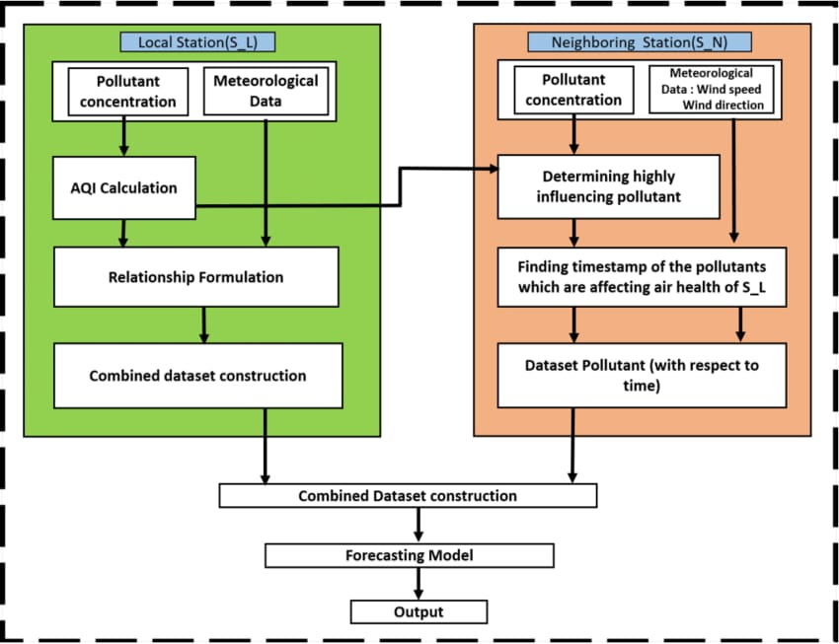
FLOWCHART OF THE PROJECT WORKFLOW

Slide 5
DATA DESCRIPTION
To predict air quality using advanced machine learning, data sets typically include historical air quality data from monitoring stations, meteorological conditions, and potentially other relevant factors like traffic data.
This datasets are used to train models that can predict future air quality, often using advanced algorithms like random forests or deep learning.
Date Description link:

Slide 6
DATA PREPROCESSING
Missing value handling: Imputation using mean, median, or interpolation
Data Formatting: Converting timestamp to datetime objects
Outline Detection: Using IQR method or Z-score to filter extreme values
Normalization/Scaling: StandardScaler or MixMaxScaler to scale features
Encoding Time Features: Extracting month, day, weekday for seasonal patterns

Slide 7
EXPLORATORY DATA ANALYSIS (EDA)
Univariate Analysis: Distribution plots of individual pollutants
Bivariate Analysis: Scatter plots and correlation matrices to study relationship between features and AQI
Temporal Trends: Line plots showing pollutant variation over time
Heatmaps: Correlation matrix showing dependencies among variables
AQI Distribution: Histogram and box plots for AQI values

Slide 8
FEATURE ENGINEERING
Time Features: Adding features like hour of day, day of week, or season
Rolling Average: Computing moving averages for pollutant levels to capture trends
Lag Features: Including values from previous time steps to capture temporal dependencies
Pollutants Ratios: Creating ratios like PM2.5/PM10 to indicate pollution types
Dimensionality Reduction: Using PCA if required for high-dimensional data

Slide 9
MODEL BUILDING
Algorithms used:
Linear Regression (as a baseline)
Random Forest Regressor
XGBoost
LSTM (for time-series data)
Training Process: Splitting the data into train/test sets, cross-validation
Evaluate Metrics: RMSE, MAE,R2 score for model performance

Slide 10
VISUALIZATION OF RESULTS AND MODEL
Predicted vs. Actual AQI: Line or scatter plots to compare model predictions
Features Importance: Bar chart from Random Forest or XGBoost
Error Distribution: Histogram of residuals (errors)
Model Comparison: Graphical comparison of performance metrics across models

Slide 11
TOOLS AND TECHNOLOGIES USED
Programming Language: Python
Libraries and Frameworks: Pandas, Numpy for data handling
Matplotlib, Seaborn for visualization
Scikit-learn for machine learning
XGBoost and TensorFlow/Keras for advanced modeling
Development Environment: Jupyter Notebook, Google Colab
Version Control: Git/GitHub
Data sources: CPCB API, OpenAQ API, Kaggle datasets

Slide 12
TEAM MEMBERS AND CONTRIBUTIONS
Data analyst: Collected datasets, performed data cleaning, and conducted EDA – KAVITHA. S
ML Engineer: Designed and trained machine learning models, features engineering – ROOBINI. S
Project Manager: Coordinated tasks, documented the project, and conducted stakeholder review – MANISHA. A
Visualization Lead: Created plots, dashboards, and presented results visually – TAMIZHVANI. R

